Slide 1










Duplication
Coloring Book
@Llewellyn Falco

Slide 2
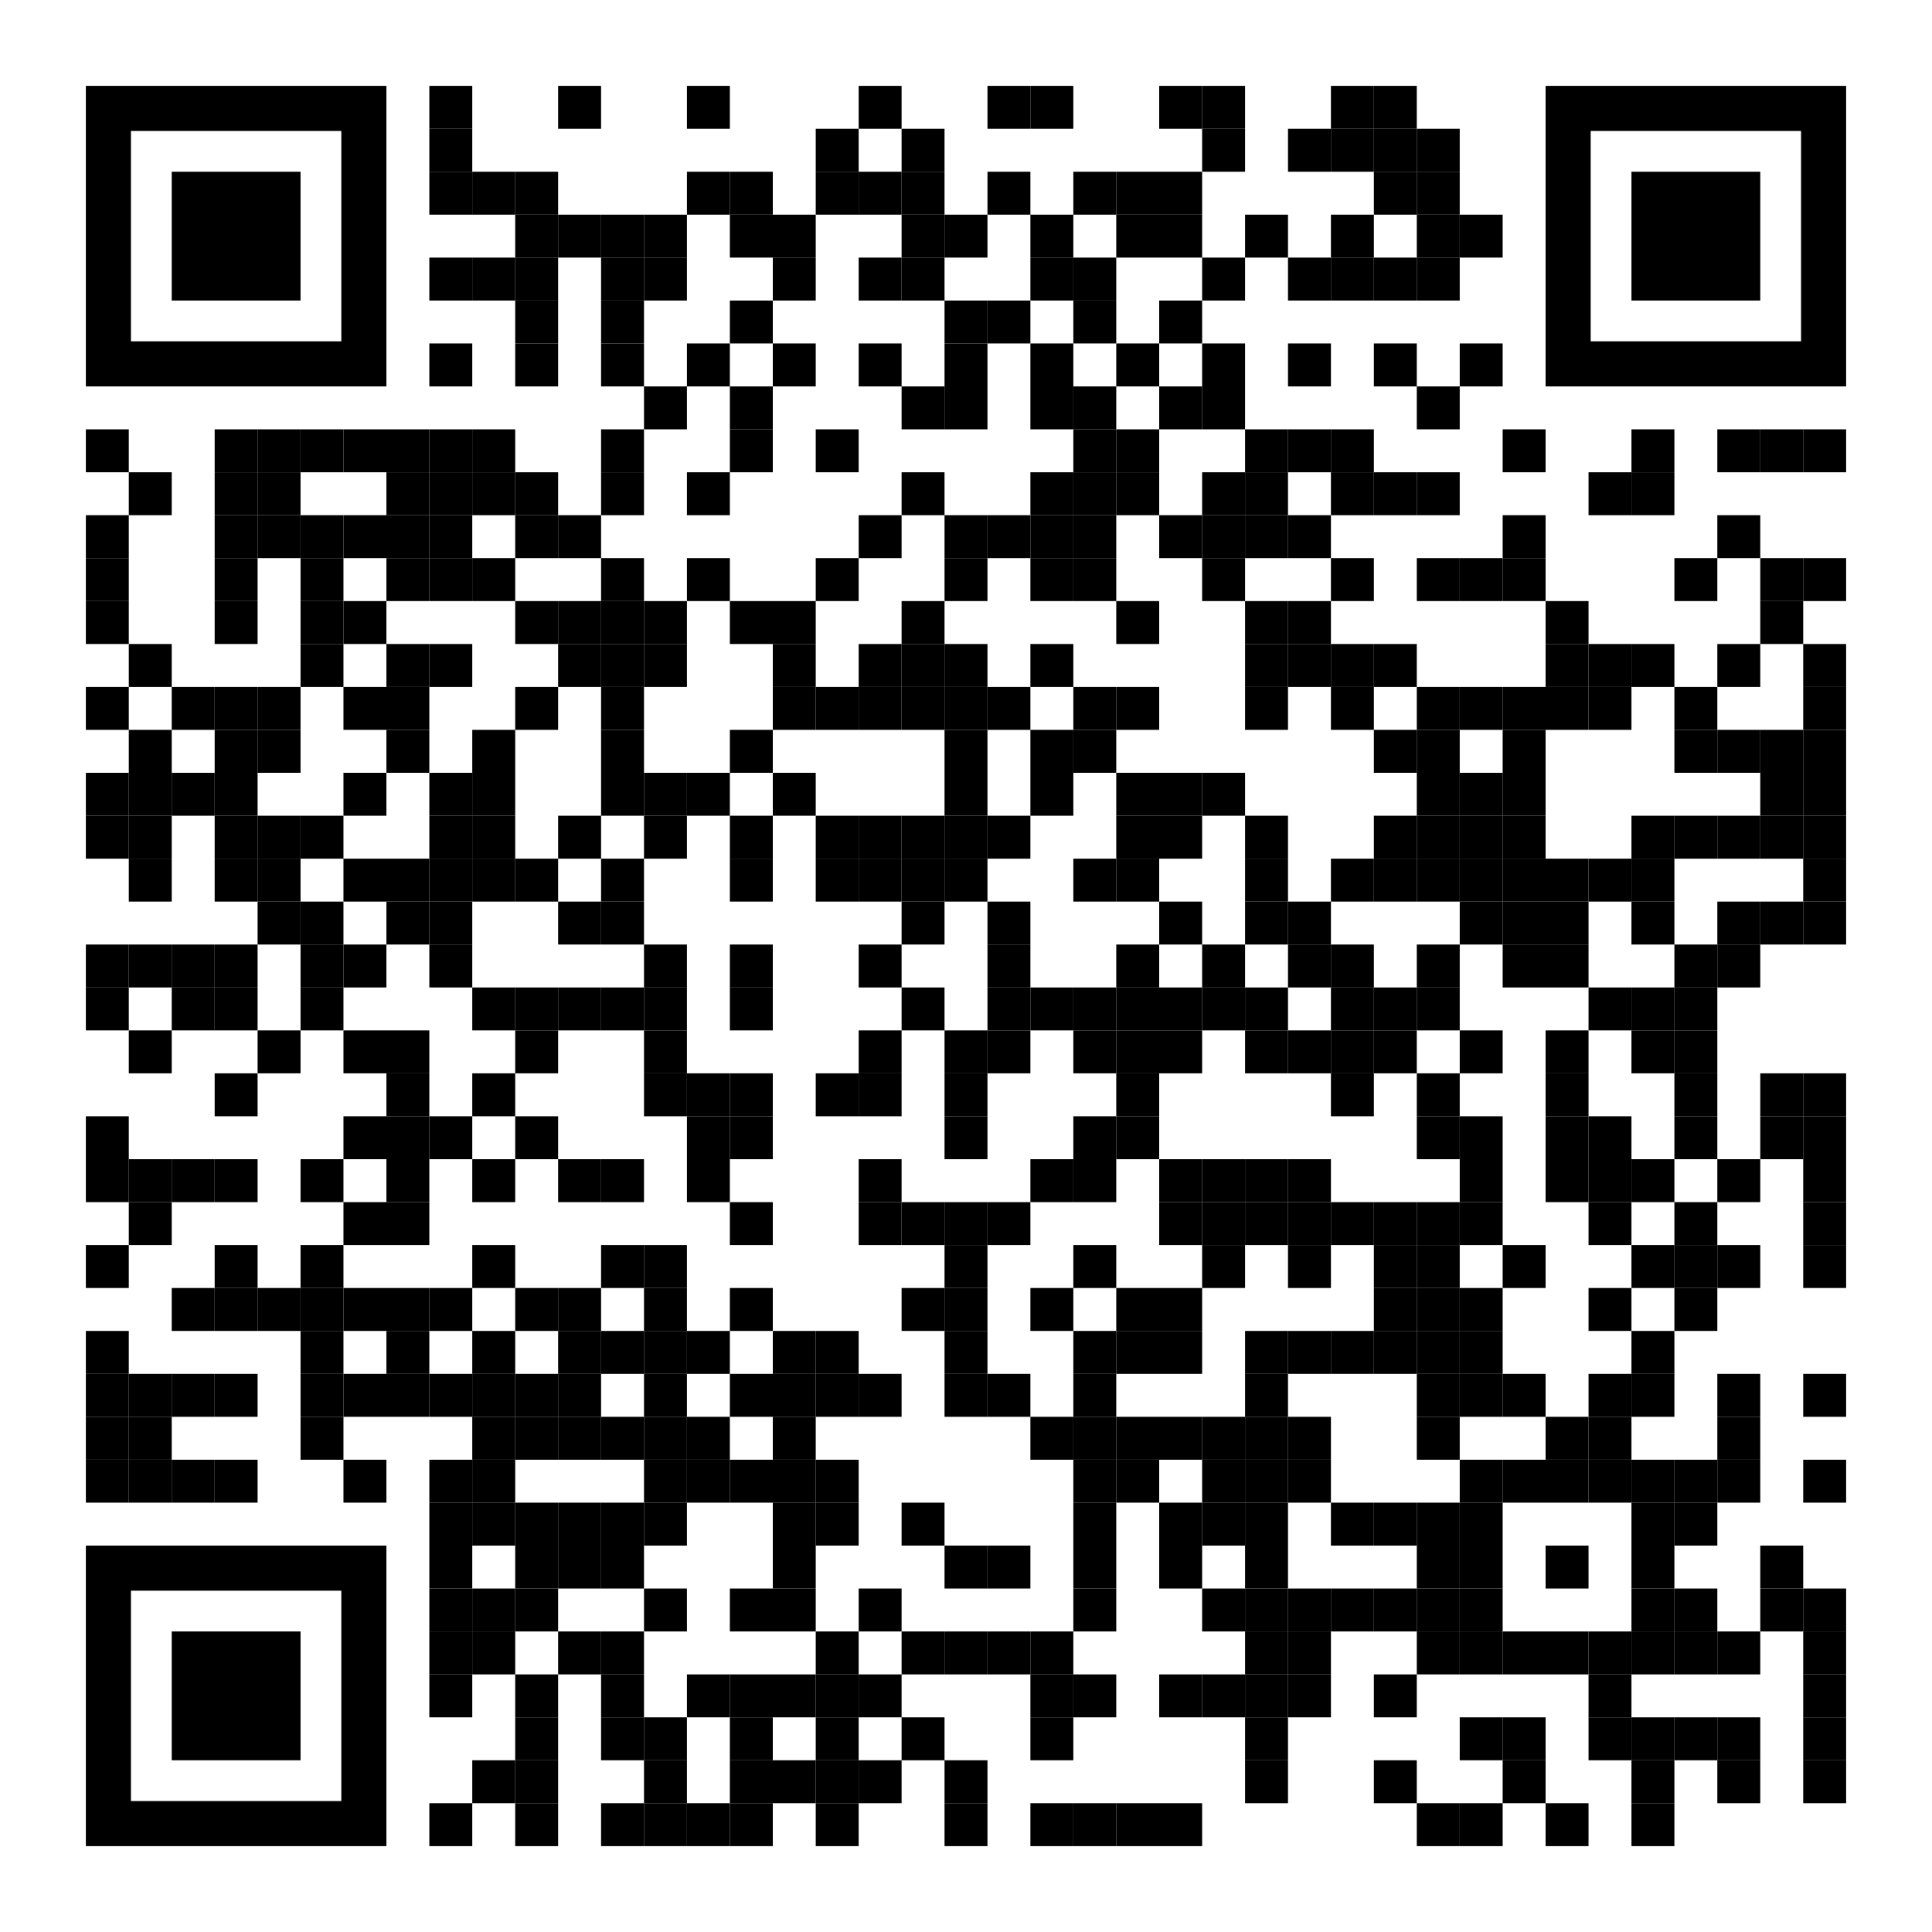
https://github.com/isidore/Talks/blob/master/DuplicationColoringBook.md#duplication-coloring-book

Slide 3
Outline
Training Patterns
Recipe For Removal
Do Process
Sparrow Decks
Coloring
Code

Slide 4
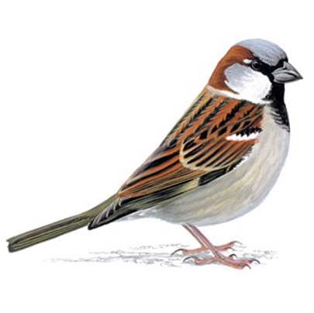
Step 1
Pattern
Training

Slide 5

Rules:
Say it aloud Try

Slide 6
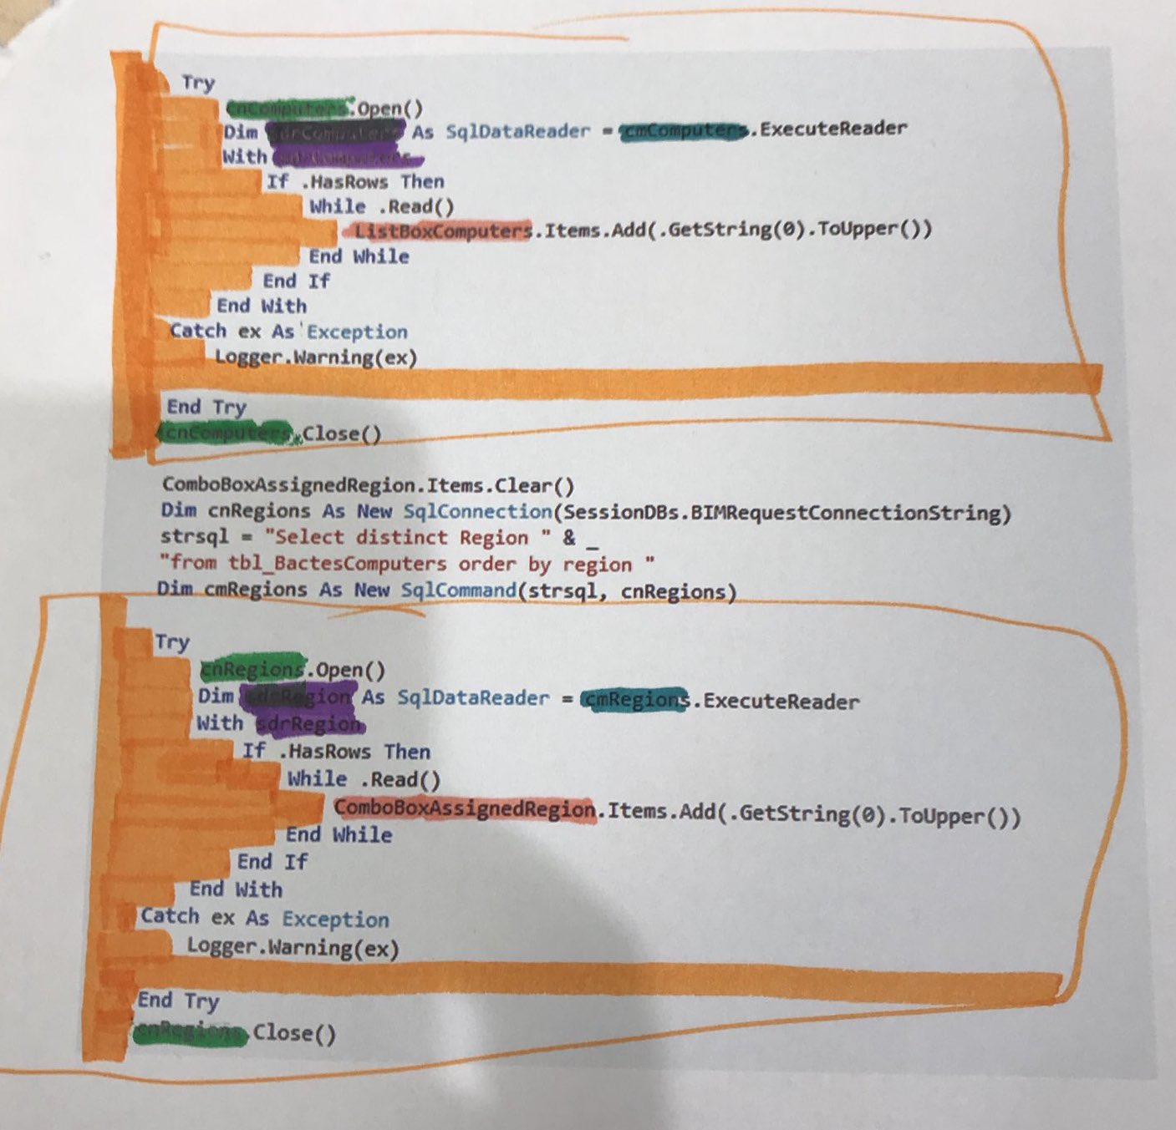
Step 2
Recipe for
Removal

Slide 7

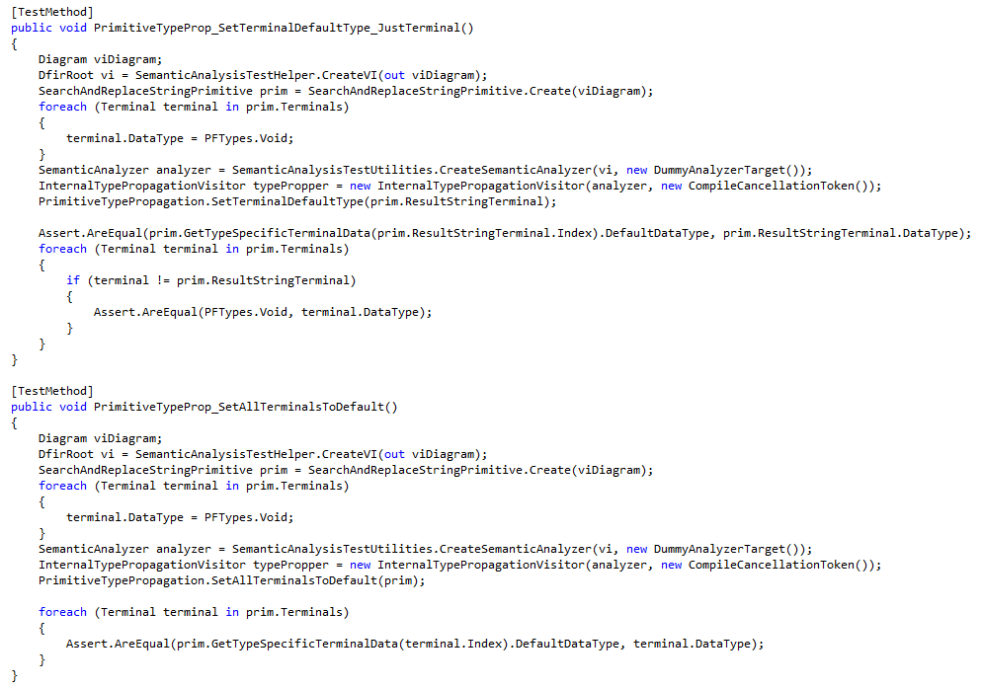
Step 1:
Draw a Box Around the Duplication

Slide 8
Step 1:
Draw a Box Around the Duplication

Slide 9
Step 1:
Color In The Whitespace

Slide 10
Step 1:
Color In The Whitespace

Slide 11
Step 1:
Color In Differences

Slide 12
Step 1:
Color In Differences

Slide 13
Step 1:
Color In Differences

Slide 14
Step 1:
Color In Differences

Slide 15
Step 1:
Color In Differences

Slide 16
Draw a box around the duplication
Fill in the whitespace
Fill in each section that is different (1 color per difference)
Steps

Slide 17
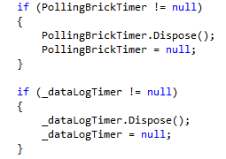
#1

Slide 18
Draw a box around the duplication
Fill in the whitespace
Fill in each section that is different (1 color per difference)
Steps

Slide 19
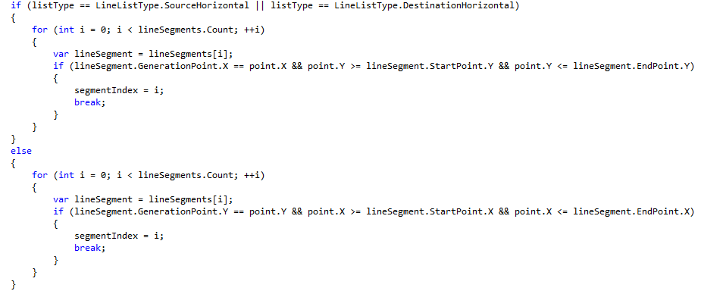
#2

Slide 20
Draw a box around the duplication
Fill in the whitespace
Fill in each section that is different (1 color per difference)
Steps

Slide 21
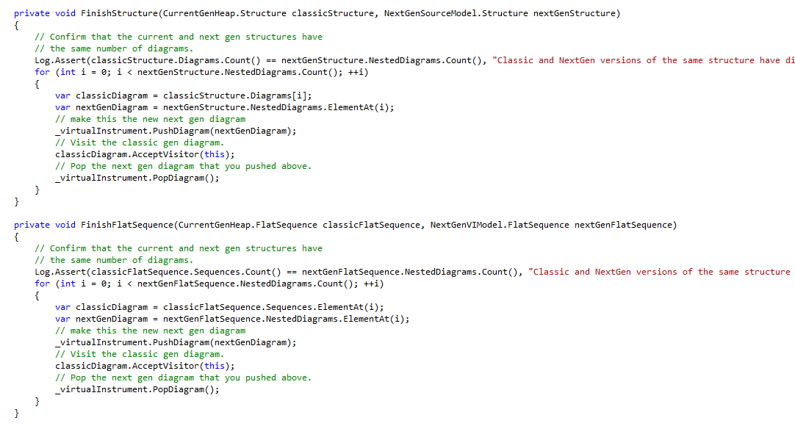
#3

Slide 22
Draw a box around the duplication
Fill in the whitespace
Fill in each section that is different (1 color per difference)
Steps

Slide 23
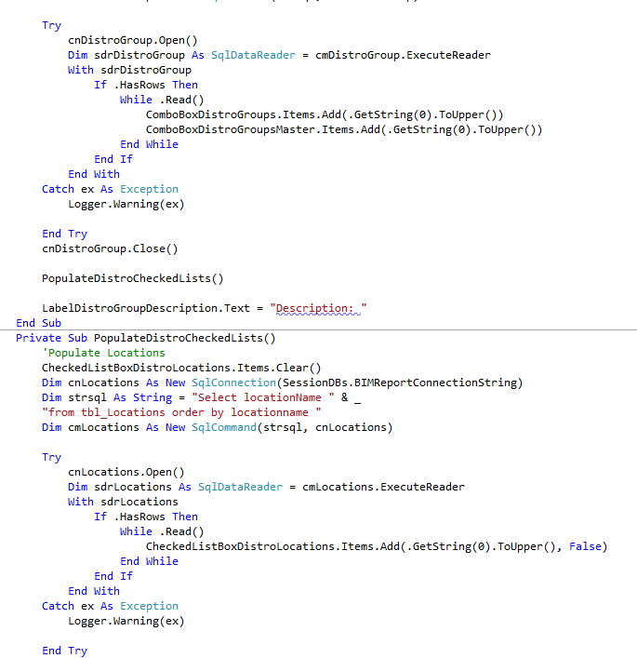
#4

Slide 24
Draw a box around the duplication
Fill in the whitespace
Fill in each section that is different (1 color per difference)
Steps

Slide 25
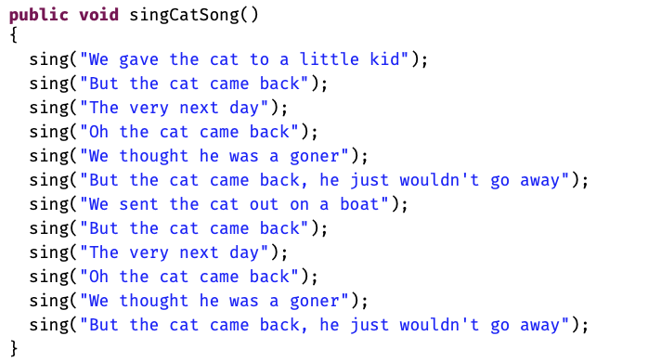
#5

Slide 26
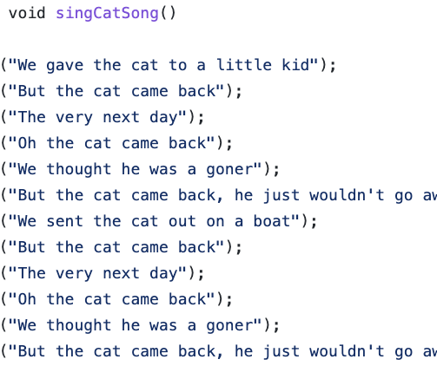
Step 3
Code

Slide 27
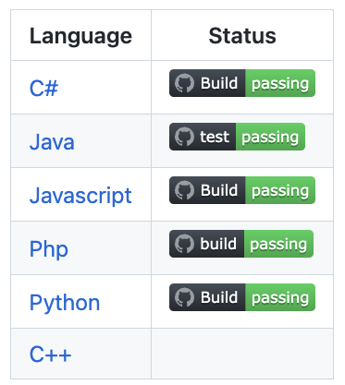
github.com/LearnWithLlew/DuplicationColoringBook

Slide 28
Lesson1Straight
Lesson2Variable
Lesson3HigherOrderFunctions

Slide 29
Drawing Boxes
sing("Hip Hip Horray! For " + name);
sing("Hello " + name + ", it's nice to meet you.");
sing("Say yeah! Say yo! Say " + name);
sing("Hello " + name + ", it's nice to meet you.");

Slide 30
Drawing Boxes = Adding Curly Braces
{
sing("Hip Hip Horray! For " + name);
sing("Hello " + name + ", it's nice to meet you.");
}
{
sing("Say yeah! Say yo! Say " + name);
sing("Hello " + name + ", it's nice to meet you.");
}

Slide 31
Lesson2Variable
Lesson3HigherOrderFunctions

Slide 32
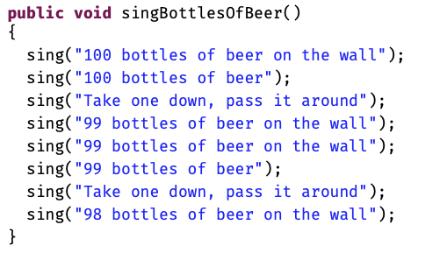
#6

Slide 33
Coloring in Differences
{
sing("Hip Hip Horray! For " + name);
sing("Hello " + name + ", it's nice to meet you.");
}
{
sing("Say yeah! Say yo! Say " + name);
sing("Hello " + name + ", it's nice to meet you.");
}

Slide 34
Coloring in Differences = Extract Variable
{
var blue = "Hip Hip Horray! For ";
sing(blue + name);
sing("Hello " + name + ", it's nice to meet you.");
}
{
var blue = "Say yeah! Say yo! Say ";
sing(blue + name);
sing("Hello " + name + ", it's nice to meet you.");
}

Slide 35
Coloring in Differences = Extract Variable
{
var blue = "Hip Hip Horray! For ";
sing(blue + name);
sing("Hello " + name + ", it's nice to meet you.");
}
{
var blue = "Say yeah! Say yo! Say ";
sing(blue + name);
sing("Hello " + name + ", it's nice to meet you.");
}

Slide 36
Lesson3HigherOrderFunctions

Slide 37
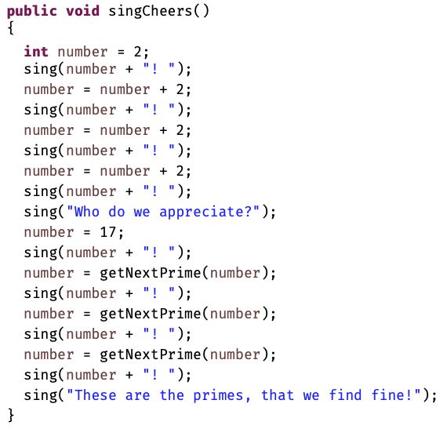
#7

Slide 38
Introduce Lambda
singLoud("Hello);

Slide 39
Introduce Lambda
((Runnable)( () -> singLoud("Hello"))).run();

Slide 40
Introduce Lambda
Runnable blue = () -> doNothing();
blue.run();

Slide 41
https://github.com/isidore/Talks/blob/master/DuplicationColoringBook.md#duplication-coloring-book

Slide 42
MINIMALIST AESTHETIC PRESENTATION
2022

Slide 43
Google Slides
Click on the "Google Slides" button below this presentation preview. Click on "Make a copy." Start editing your presentation. You need to sign in to your Google account.
How to
Use This Presentation
Canva
Click on the "Canva" button under this presentation preview. Start editing your presentation. You need to sign in to your Canva account.
PowerPoint
Click on the "PowerPoint" button below this presentation preview.
Start editing your presentation. Download and install the fonts used in this presentation as listed on the next page.

Slide 44
Table Of Contents
About Us
Our Projects
Stats & Numbers
Briefly elaborate
on what you want
to discuss.
Briefly elaborate
on what you want
to discuss.
Briefly elaborate
on what you want
to discuss.

Slide 45
01.
ABOUT US
Briefly elaborate on what you want
to discuss.

Slide 46
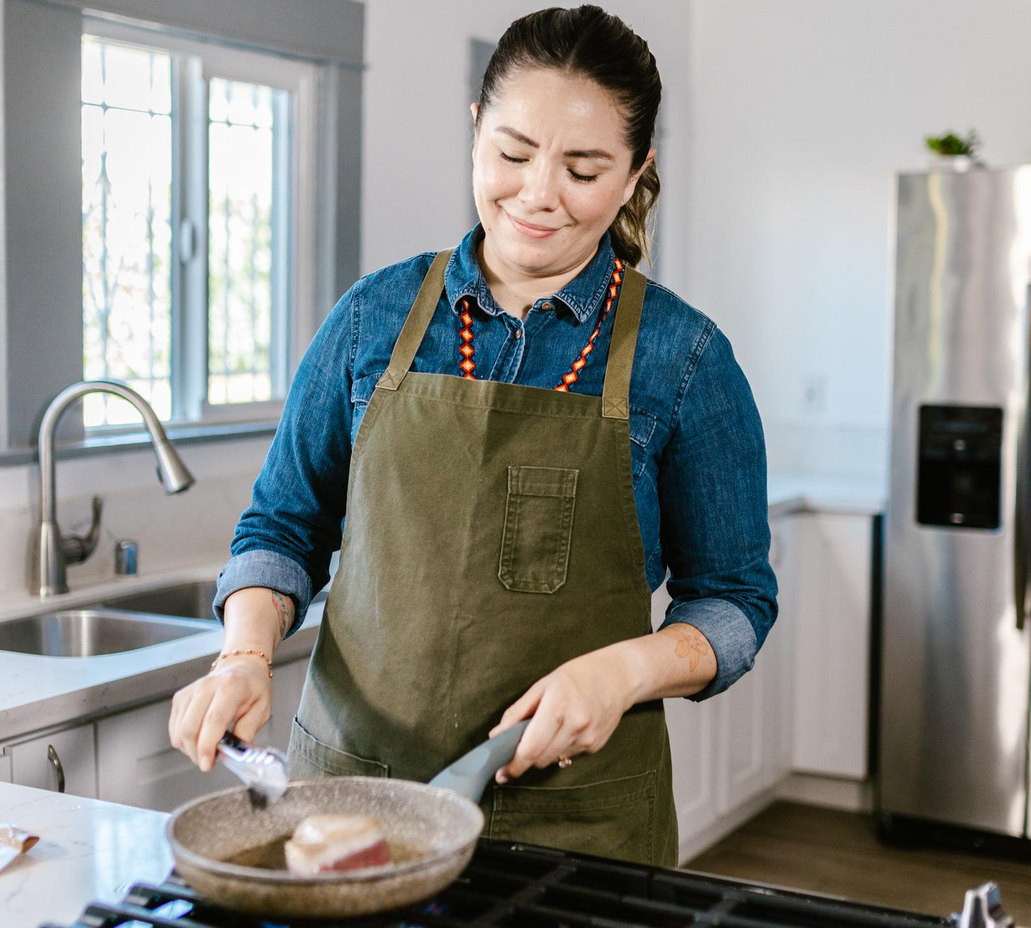
Welcome To Presentation
I'm Rain, and I'll be sharing with you my beautiful ideas. Follow me at @reallygreatsite to learn more.

Slide 47
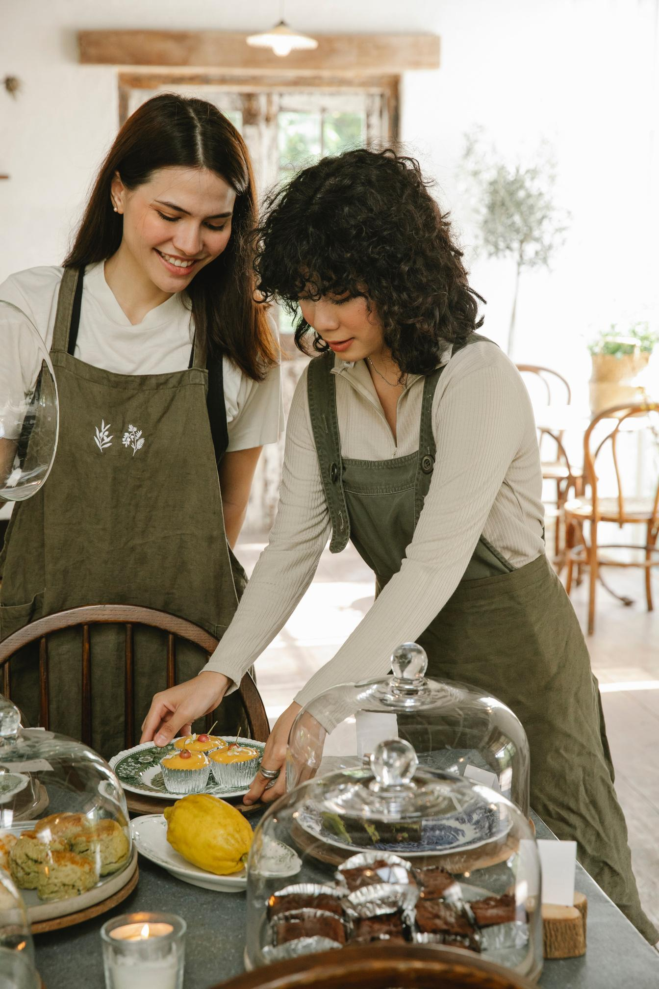
About Us
Who we are?
Briefly elaborate on what you want to discuss.
What we do?
Briefly elaborate on what you want to discuss.

Slide 48
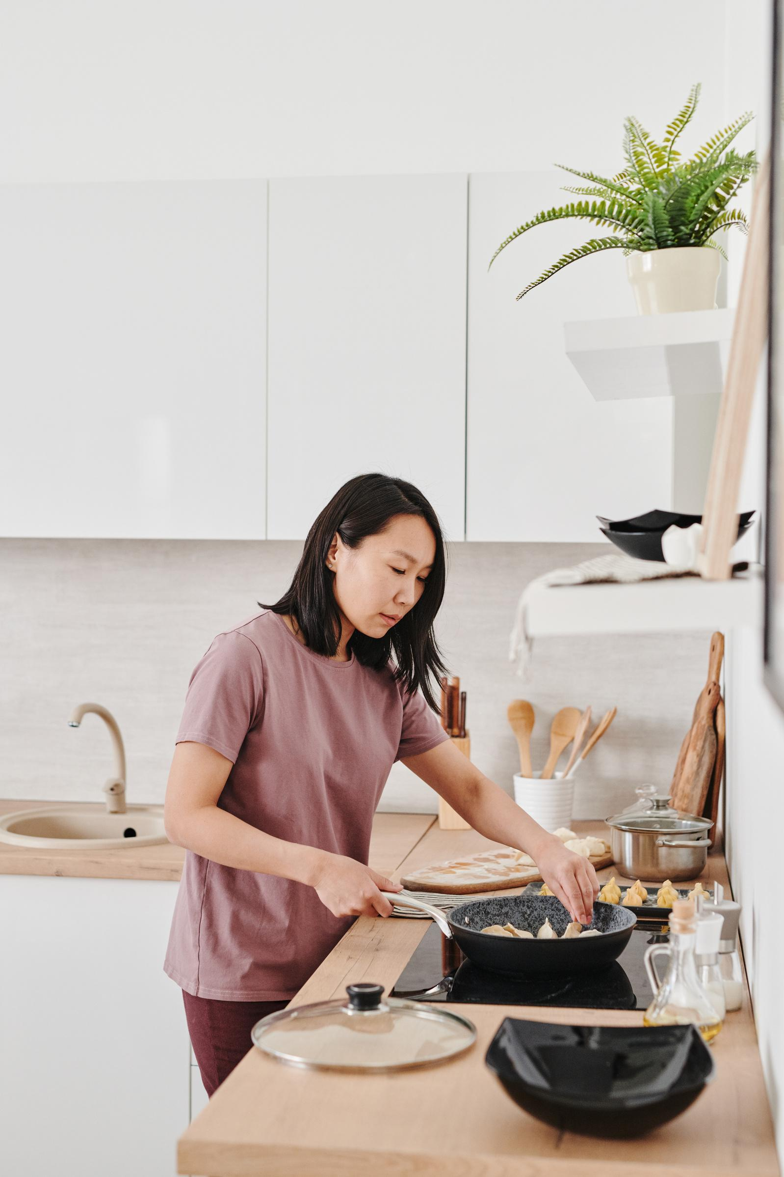
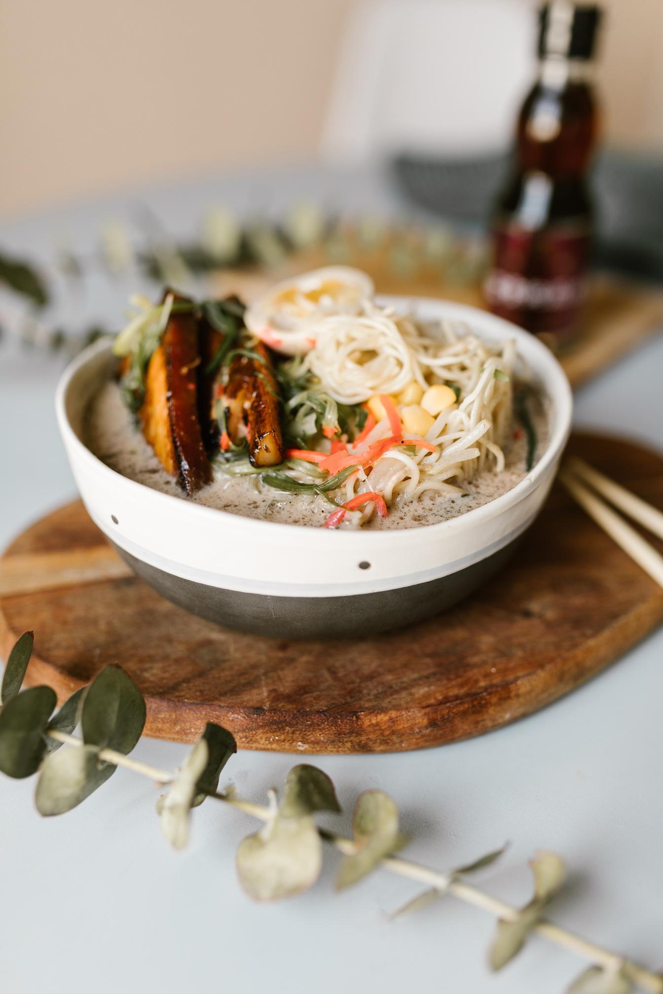
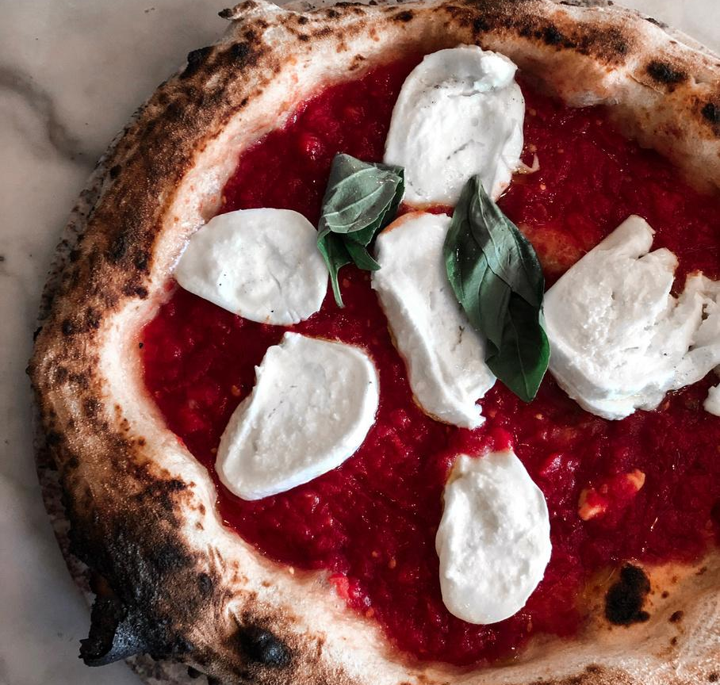
Gallery Image
What can you say about your projects?
Share it here!

Slide 49
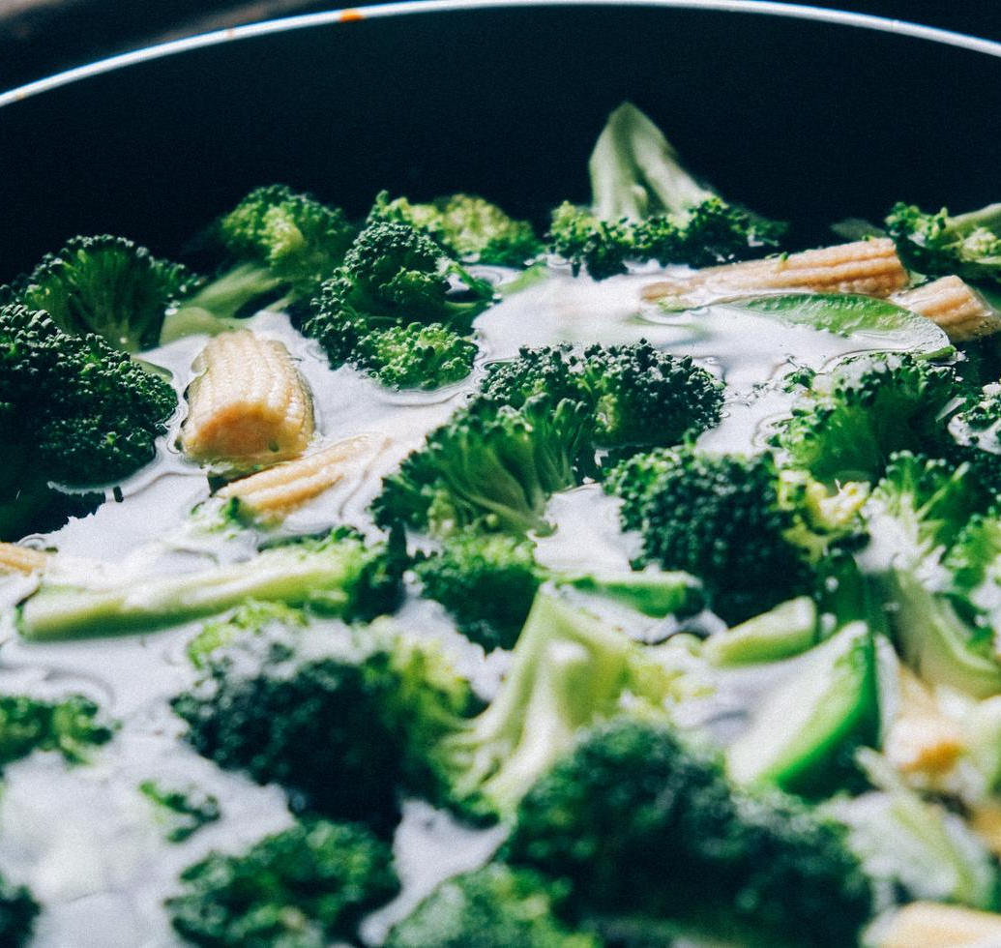
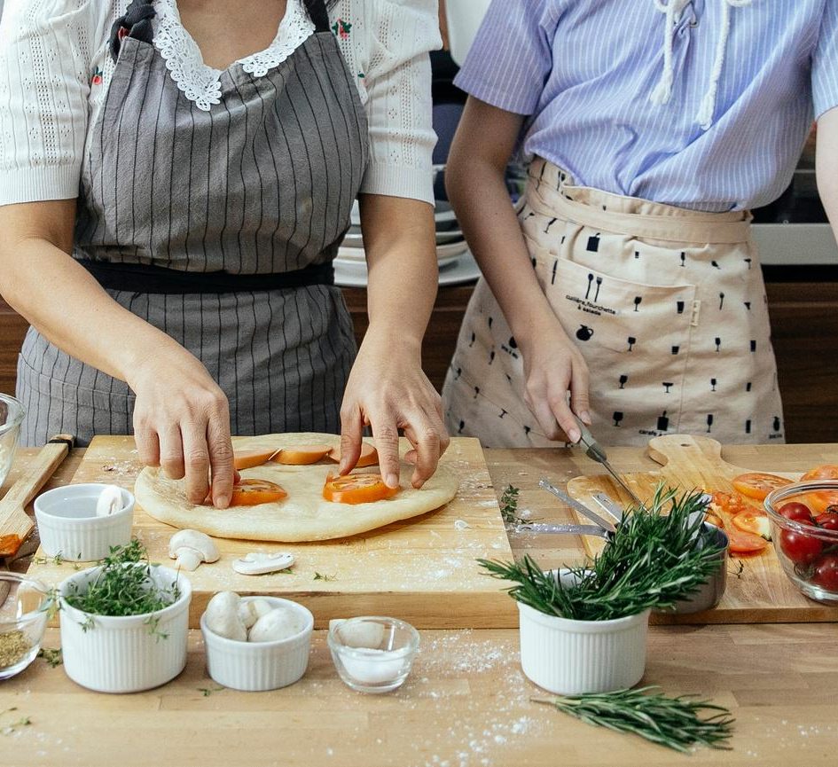
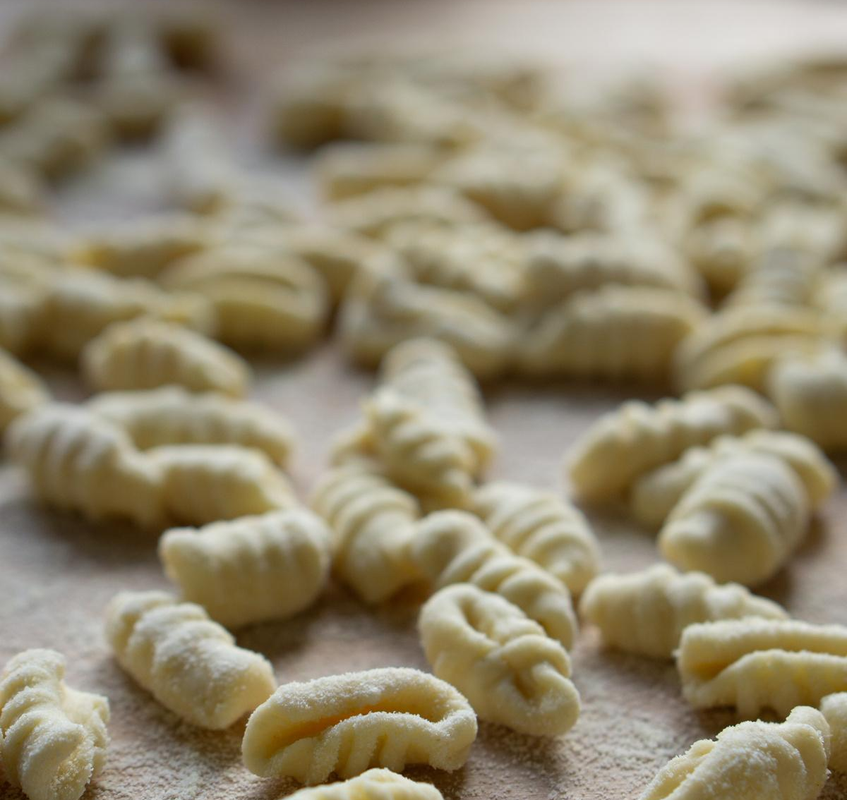
Write Your Idea
Add a main point
Add a main point
Add a main point
Briefly elaborate on what you want to discuss.
Briefly elaborate on what you want to discuss.
Briefly elaborate on what you want to discuss.

Slide 50

Write an original
statement or
inspiring quote
— Include a credit, citation, or supporting message

Slide 51



Meet Our Team
Name Surname
Name Surname
Name Surname
Title
Title
Title

Slide 52



Testimonials
Client name
Client name
Client name
Elaborate on what you want to discuss.
Elaborate on what you want to discuss.
Elaborate on what you want to discuss.

Slide 53
02.
OUR PROJECTS
Briefly elaborate on what you want
to discuss.

Slide 54
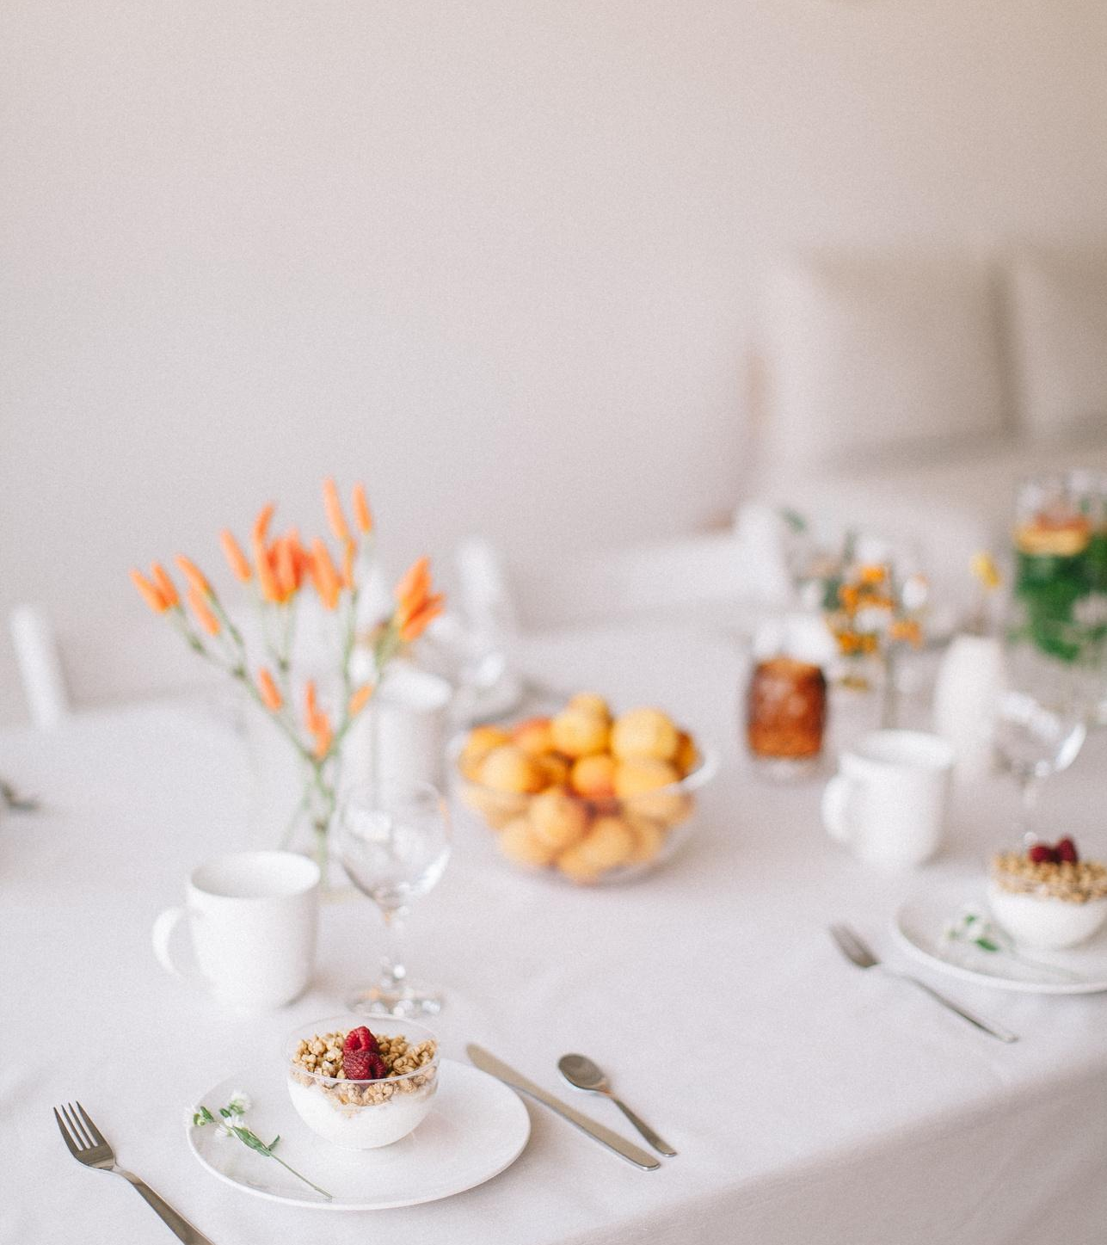
Your Project
Presentations are communication tools that can be used as demonstrations, lectures, speeches, reports, and more. It is mostly presented before an audience. It serves a variety of purposes, making presentations powerful tools for convincing and teaching.
YEAR: 2022
ROLE: WRITE YOUR ROLE

Slide 55
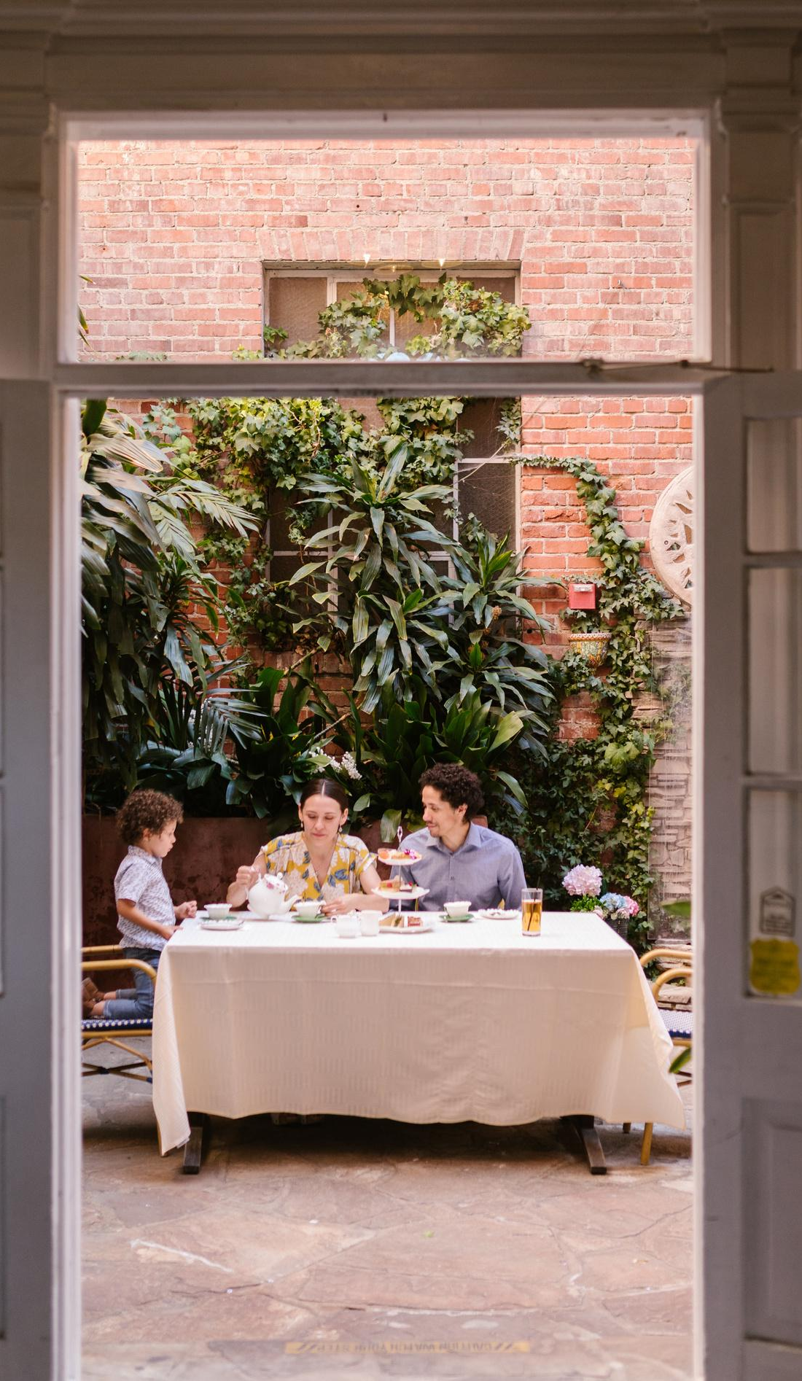

A picture is worth a thousand words
What can you say about your projects?
Share it here!

Slide 56
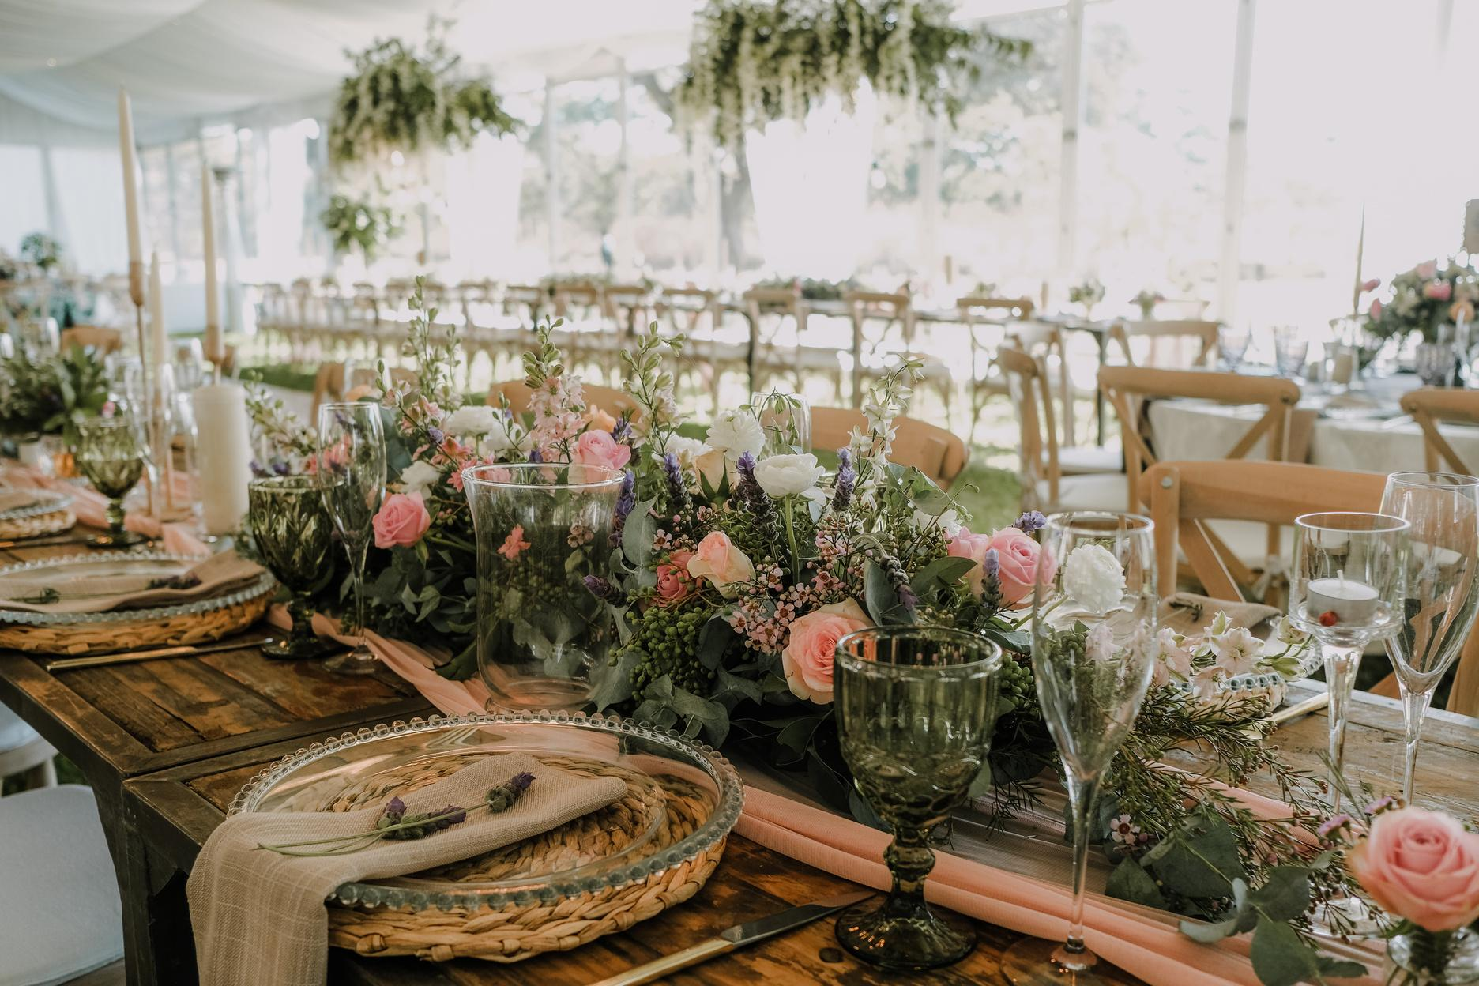
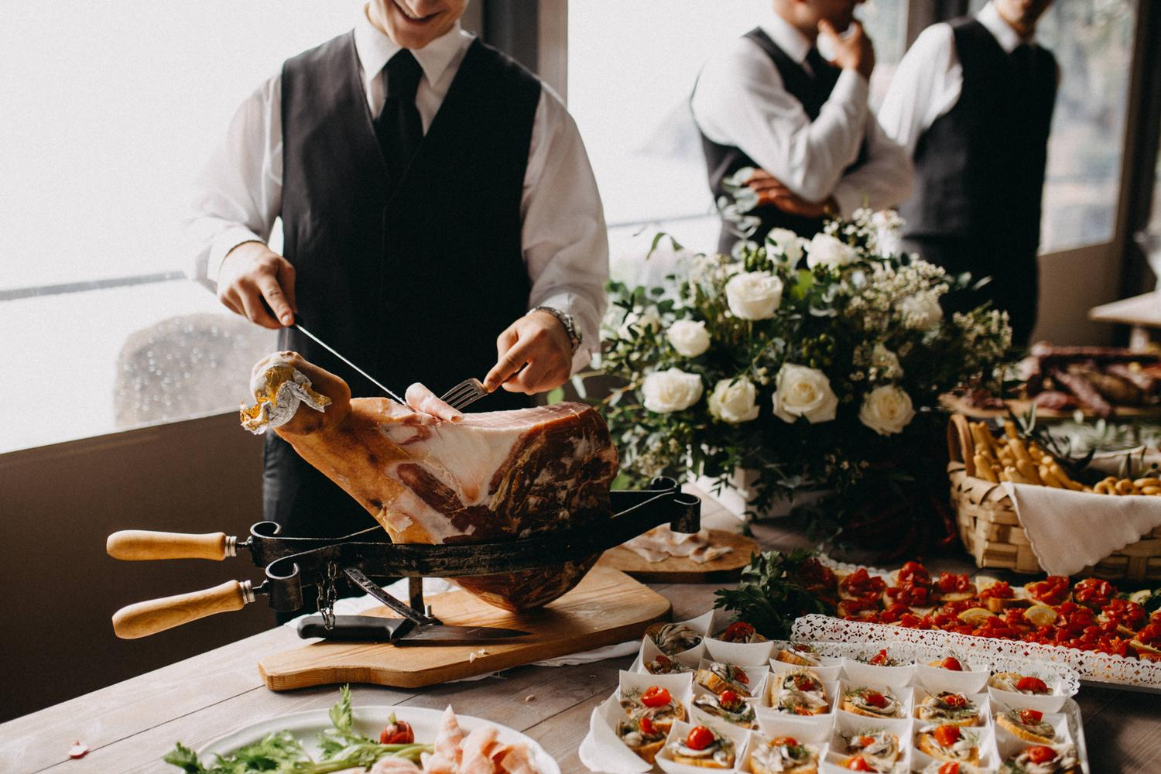
Our Services
01
02
03
Add a main point
Add a main point
Add a main point
Elaborate on what you want
to discuss.
Elaborate on what you want
to discuss.
Elaborate on what you want
to discuss.

Slide 57

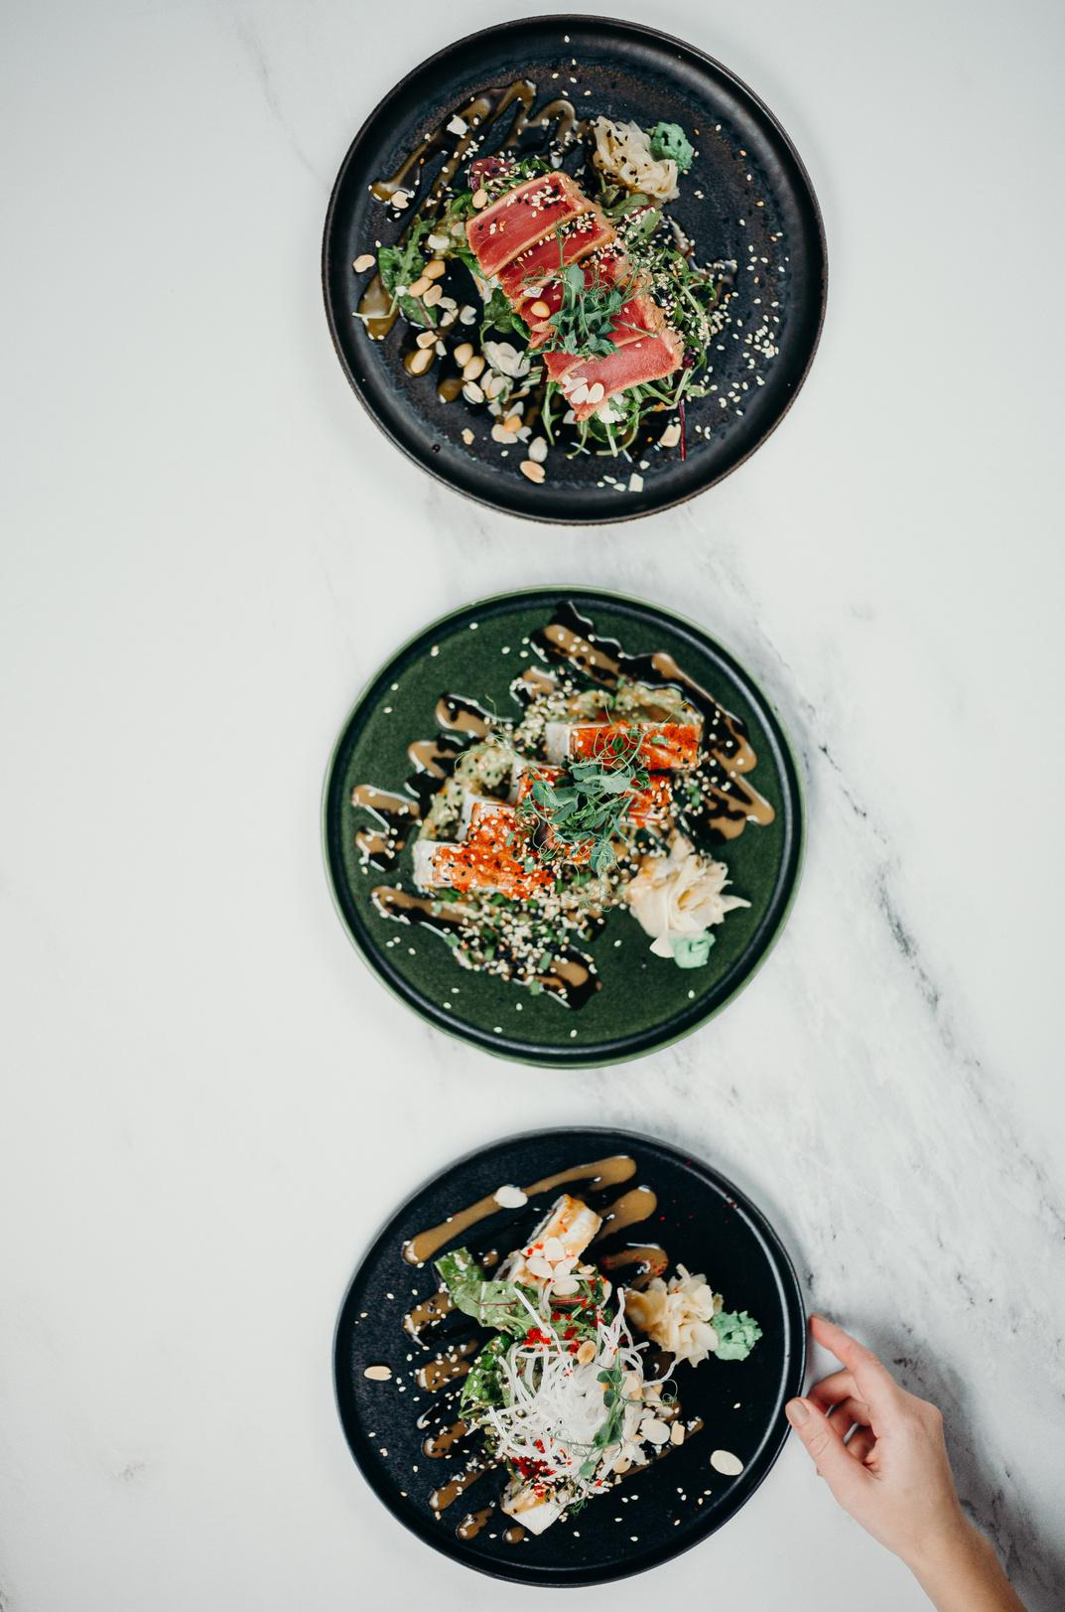
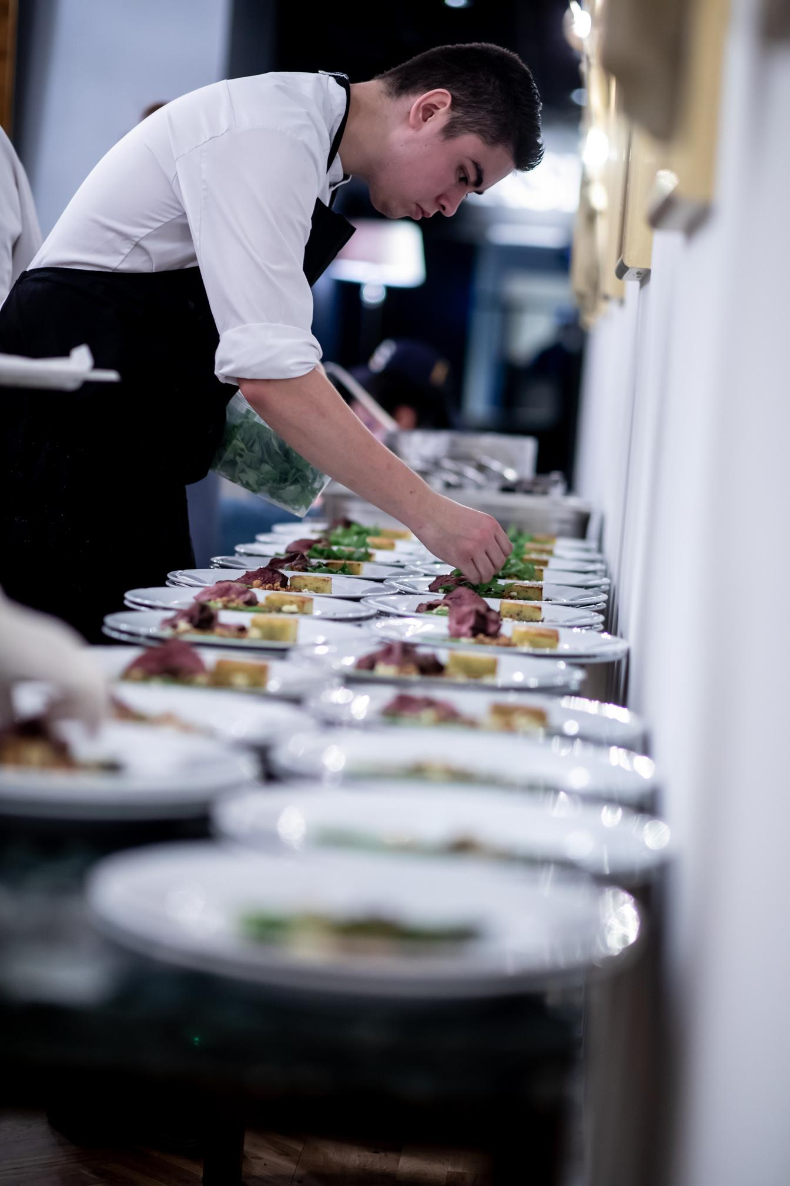
Phone
Mockup
What can you say about your projects?
Share it here!

Slide 58
03.
STATS & NUMBERS
Briefly elaborate on what you want
to discuss.

Slide 59
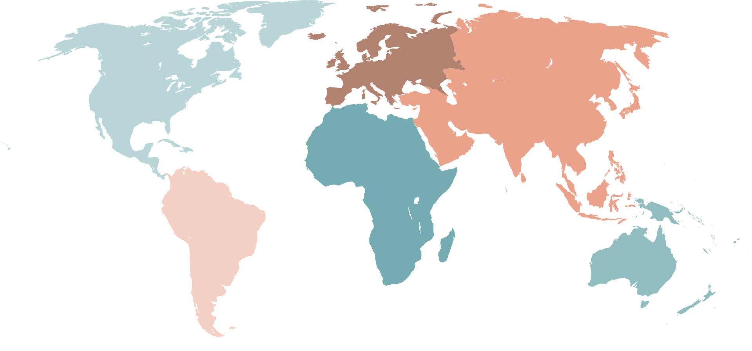
World Map Report
Step One
Step Two
Presentations are
communication tools
Presentations are
communication tools
Step Three
Step Four
Presentations are
communication tools
Presentations are
communication tools

Slide 60
50
40
Write Your
Topic or Idea
30
20
Elaborate on the featured statistic.
10
0
Item 1
Item 2
Item 3
Item 4
Item 5

Slide 61
Add a Pricing Page
20$
30$
300$
MONTHLY
MONTHLY
YEARLY
Add a feature
Add a feature
Add a feature
Add a feature
Add a feature
Add a feature
Add a feature
Add a feature
Add a feature
Add a feature
Add a feature

Slide 62
RESOURCE
PAGE
Use these design resources in your Canva Presentation.
Happy designing!
Don't forget to delete this page
before presenting.

Slide 63

Fonts In this Presentation
This presentation template uses the following free fonts:
Titles: Nunito Light
Headers: Nunito Sans Black
Body Copy: Nunito Light

Slide 64
Credits
This presentation template is free for everyone to use thanks to the following:
SlidesCarnival for the presentation template
Pexels for the photos
Happy designing!

Slide 65

Free templates for all your presentation needs
For PowerPoint, Google Slides, and Canva
100% free for personal or commercial use
Ready to use, professional, and customizable
Blow your audience away with attractive visuals

